Slide 1




P
A
R
A
L
L
E
L
S
U
D
O
K
U

Slide 2

Why Parallel? Combinatorial explosion
- Modern computers provide computational power that enables several algorithms to solve 9x9 Sudoku puzzles in fractions of a second.
- As the size of the Sudoku puzzle (n) increases, such as 16x16 or 25x25, combinatorial explosion occurs, leading to exponential growth in overall solving time.
- Combinatorial explosion limits the properties of Sudokus that can be constructed, analyzed, and solved.
- It eliminates the possibility of solving Sudoku in a reasonable amount of time.
Rules
Each number must appear exactly once in each row.
Each number must appear exactly once in each column.
Each number must appear exactly once in each box.
The above rules imply no duplicate numbers in any row, column and box.

Slide 3

Parallel Approach
Initialization: Read the Sudoku puzzle from an input file. Store the puzzle in a 2D vector called board.
Solving the Puzzle: Start the solving process by calling the solve() function which launches multiple threads to solve the puzzle concurrently. Each thread starts from a different empty cell and tries to fill it with a valid number.
Validity Checking: The isValid() function checks if a number is valid at a given position. It checks the row, column, and 3x3 box to ensure no conflicts with the placement of the number.
Synchronization: The board data structure is accessed and modified by multiple threads concurrently. To avoid data races, a mutex named board_mutex is used to synchronize access to the board. The set_board_data() function acquires a lock using lock_guard before modifying the board.
Output: If a solution is found, the solved Sudoku puzzle is printed to the console.The solution is also written to an output file named "solution.txt". If no solution is found, a message indicating "NO SOLUTION FOUND!" is printed.

Slide 4
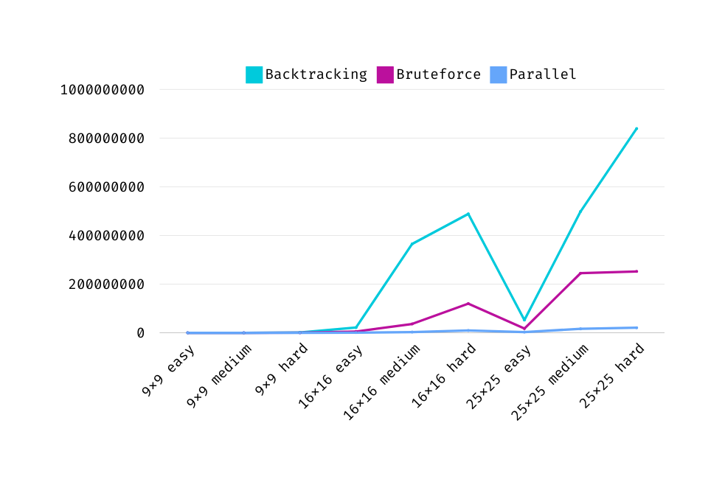
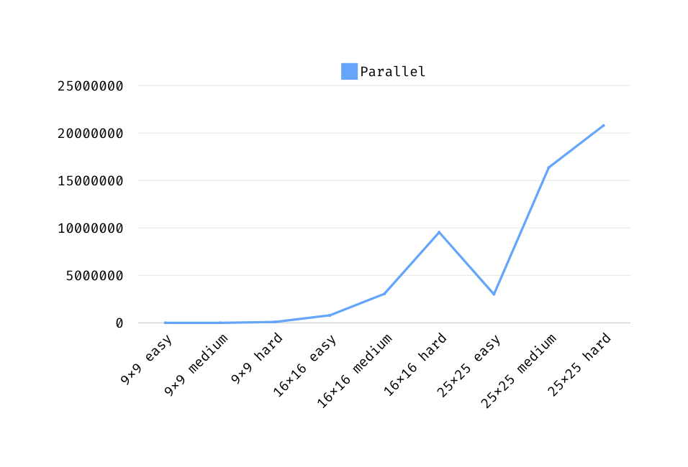
Execution Time - Size and Level

Slide 5
T
H
A
N
K
Y
O
U
Any Questions?

